Slide 1
Salary Analysis using Excel
STUDENT NAME: HAKSHIYA R.H
REGISTER NO:312208936
DEPARTMENT:BACHELOR OF COMMERCE
COLLEGE:CHEVALIER T.THOMAS ELIZABETH COLLEGE FOR WOMEN

Slide 2
PROJECT TITLE
Salary Analysis using Excel

Slide 3


AGENDA
Problem Statement
Project Overview
End Users
Our Solution and Proposition
Dataset Description
Modelling Approach
Results and Discussion
Conclusion
3/21/2024 Annual Review

Slide 4

PROBLEM STATEMENT
Objective: Analyze the salary data of employees to identify trends, patterns, and potential areas of improvement such as salary inequalities, the impact of various factors on salaries, and overall salary distribution across the organization.

Slide 5

PROJECT OVERVIEW
1. Data Collection and Preparation - Collect salary and employee data, including variables such as job titles, departments, years of experience, education level, gender, location, and performance ratings.
2. Exploratory Data Analysis (EDA) - Perform initial data exploration using descriptive statistics to get an overview of the salary distribution.
3. Key Analyses - Salary Distribution: Examine how salaries are distributed across the organization. - Department and Role Analysis: Compare average, median, and range of salaries across different departments and job titles. - Experience and Education Impact: Analyze how factors like years of experience and education level affect salaries. - Gender Pay Gap Analysis: Investigate salary differences between male and female employees to identify any pay gaps. - Performance-Based Salary Analysis: Assess the correlation between performance ratings and salary levels.

Slide 6
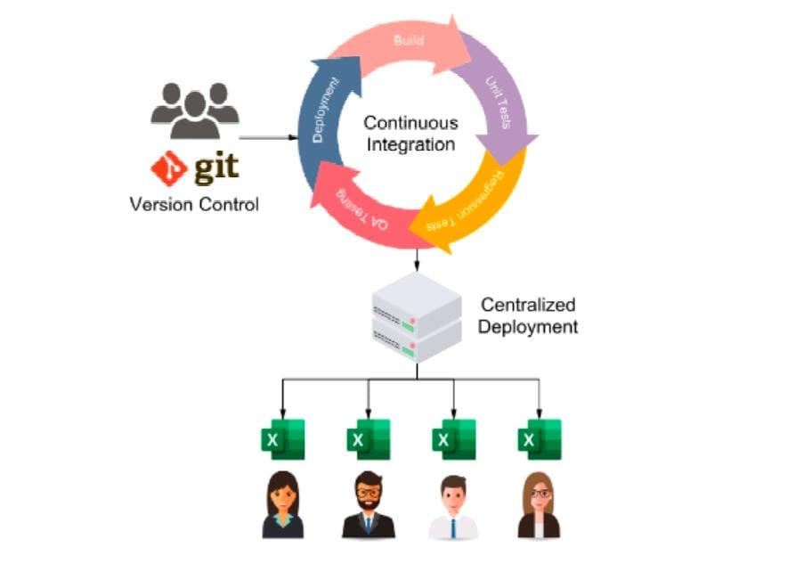


WHO ARE THE END USERS?

Slide 7

OUR SOLUTION AND ITS VALUE PROPOSITION
Our Excel-based salary analysis solution provides a practical, accessible, and powerful tool for organizations to optimize their compensation strategies, promote fairness, and support data-driven decision-making. It delivers clear, actionable insights that drive value across the organization, enhancing both employee satisfaction and organizational performance.

Slide 8
Dataset Description
The dataset for salary analysis typically contains various attributes related to employees and their compensation. This dataset structure provides a comprehensive view that enables robust salary analysis across multiple dimensions, helping organizations make informed decisions on compensation strategies. Let me know if you need any more specific details or have other questions!

Slide 9

THE "WOW" IN OUR SOLUTION
Our Excel-based salary analysis solution stands out by delivering powerful, actionable insights with a user-friendly approach. Here’s what makes our solution impressive and why it’s a game-changer for organizations:
Accessibility and Ease of Use:
Wow Factor: We utilize Excel, a tool that is already widely available and familiar to most business professionals. No need for expensive, complex software or extensive training—our solution is accessible to everyone, from HR managers to executives.
Impact: This accessibility allows teams to quickly adopt the solution and start generating insights without a steep learning curve.
Dynamic Dashboards and Visualizations:
Wow Factor: Our solution includes dynamic, interactive dashboards that present data in visually compelling ways. From heat maps showing pay discrepancies to trend lines forecasting future salary shifts, the visual tools turn raw data into a story that’s easy to understand and act upon
3/21/2024 Annual Review
9

Slide 10
MODELLING
Modeling in salary analysis involves using statistical and analytical techniques to understand the factors that influence salaries and predict salary outcomes. Below are key modeling approaches you can implement using Excel to enhance your salary analysis:
Descriptive Modeling:
Objective: To summarize and describe the main features of the salary data
.Techniques Used :
.Summary Statistics: Calculate mean, median, standard deviation, minimum, and maximum salaries across various dimensions (e.g., departments, job titles, gender).
.Pivot Tables: Summarize data to compare salary distributions across multiple categories, such as experience levels or education qualifications.
2. Exploratory Data Analysis (EDA):
Objective: To visually explore the data to identify patterns, trends, and anomalies.Techniques Used:
Histograms: To visualize the distribution of salaries across the organization
.Box Plots: To identify outliers and compare salary ranges between groups.
.Excel Tools: Insert Charts (Histograms, Scatter Plots, Box Plots).
10

Slide 11
RESULTS
11

Slide 12
conclusion
The salary analysis conducted using Excel provides a comprehensive understanding of the organization’s compensation structure, highlighting key trends, disparities, and actionable insights. This salary analysis has equipped the organization with the insights needed to make informed decisions about compensation strategies, driving improvements in fairness, competitiveness, and employee satisfaction. By addressing the identified disparities and aligning pay structures with organizational goals, the company can foster a more equitable and motivated workforce.Ongoing monitoring and refinement of salary policies, based on continuous data analysis, will be essential to maintaining a fair and effective compensation strategy that supports both employee well-being and organizational success.

